Slide 1
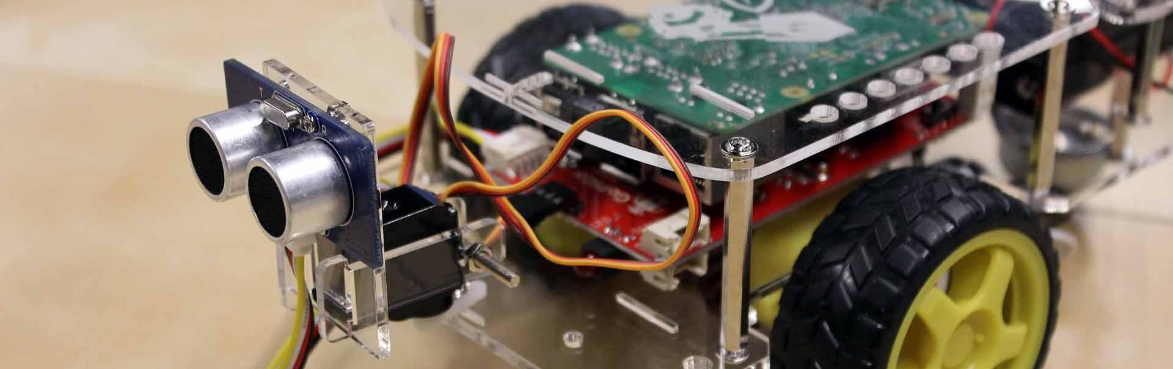
GoPiGo Box Locator
Group members: Eric Clifford, Ernest martin, Phillip pappan, Ray thibodeaux

Slide 2
Problem / solution
When dealing with large organizations such as UPS, FedEx, and USPS, package organization is key to operational success. When boxes are misplaced, which they quite often are, packages get sent to the wrong address, get stuck in transit for far longer than they should have or worse, go into a big black hole never to be seen again. All of these scenarios have something in common, they cut into the bottom line. Most of these companies have policies in place that state if a package doesn’t arrive on time, shipping fees will be refunded.
Our goal for this project is to begin the steps of creating a piece of technology that could alleviate some of these problems by turning our GoPiGo car into a automated box locator. Hopefully that box location data could then be used by other technologies to identify and even move the box to the appropriate place. Thus, leading to increased operational success and profit.

Slide 3
Objectives
Locate all the boxes along a path.
In multi-billion-dollar organizations, such as UPS, time is money, so do so in the quickest time possible.
While also avoiding collisions.
Structure program in a way that allows for the future addition of components, such as bar code readers, to utilize the box locations.

Slide 4
Alternative solutions
Solution 1: Car scans left and right and then moves forward a distance that is equal to the average length of a box. If a box is found, that information is made available to the user. This process repeats until the end of the route is reached.
Solution 2: The car moves in a continuous manner, while simultaneously scanning for boxes at a rightward diagonal position, followed by a forward position. If a box is detected the car will stop in front of the detected box and that box location will be made available for use. If the end of route is reached, the car turns around to scan for boxes on its other side.

Slide 5
Solution 1
Pros:
Simpler to develop when compared to solution 2
Car has to make only one pass down its route
Less resource intensive
Cons:
Car only moves an average box length at a time before stopping to scan
The further boxes are apart, the more time that gets wasted scanning empty space. This could lead to this solution being significantly slower than solution 2
Dependent on boxes being a certain average length. If a box length is significantly bigger or smaller than the average box length, boxes could be double counted or missed

Slide 6
Solution 2
Pros:
Much more adaptable to changing variables, such as box length
Car moves continuously, only stopping beside a detected box and to turn around
This means that this solution has the potential of being significantly quicker than solution 1 if the boxes are on average distanced further than a box length apart
Cons:
More complex to implement
Slightly more resource intensive
Car must make two passes down its route

Slide 7
Decision
Although slightly more complex and resource intensive, solution 2 seems to be the better of the two solutions. The pros from using solution 2, in the form of time saved, far outweigh its cons. Furthermore, solution 1 is overall less adaptable to certain scenarios that could arise. For example, if boxes are spaced apart by a considerable amount on average, the car will spend a unnecessary amount of time stopping to scan empty space. Also, being reliant on an average box length isn’t the best, boxes, such as the ones used by shippers, can vary significantly in length.

